Slide 1

Stack Overflow Auto-Search Tool

Slide 2




Overview
Flow Chart
Extract Error Message
Stack Exchange API
Auto-Searching For Threads

Slide 3

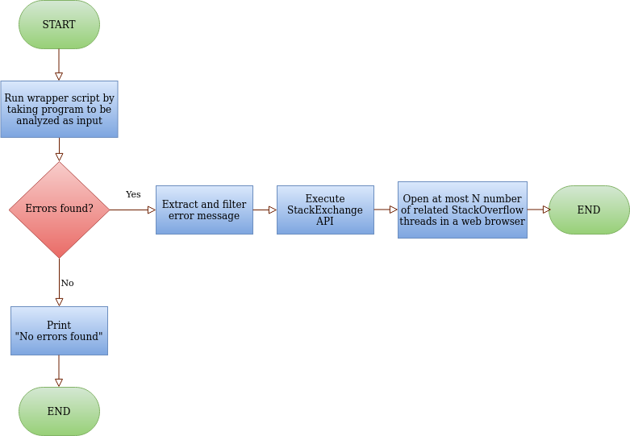
In this project we are going to create a tool (Python script) that will check our Python program for errors by executing it and on encountering any errors, it will search for it on Stack Overflow and open up a few threads in web browser tabs.

Slide 4



Extract Error Message
Using the Subprocess Module in your wrapper script to execute the test program.
The data will contain details like file name, line number, wrong statement, the type of error, the error message, etc. We only need the type of error and the error message, hence we need to filter for the same.

Slide 5


Stack Exchange API is REST service that takes an URI Query String request based on HTTP/HTTPS and returns JSON/JSONP response enabling users to retrieve questions, answers, comments, badges, events, revisions, suggested edits, user information, and tags from the site.
Stack Exchange API

Slide 6

Auto-searching for Stack Overflow threads
After successful extraction of the error message, the next step is to use the Stack Exchange API’s search feature and open up a few Stack Overflow threads that relate to the error.
Extract at most N (5 for example) number of links that relate to Stack Overflow threads which are answered.

Slide 7

Thank you
Tushar Gupta
PSIT-CS-III-A
101640100302

